Slide 1
Notes to the Presenter
Slides 2-10 contain notes for the presenter and are hidden.
You may include your picture and company logo on the intro slide only
It is appropriate to provide a brief background (1 minute or less) on your organization.

Slide 2
Presentation Best Practices
Frame your presentation by answering:
What do you want your audience to learn?
What do you want your audience to do differently?
What result or outcomes do you want your audience to realize?
Clarify your session objectives at the beginning of your presentation.

Slide 3
Presentation Best Practices
Pictures speak 1,000 words; include a screenshot or picture on each slide to add visual interest.
A good goal is to aim for 7 words per slide.
Increase attention and interaction by using a variety of communication mediums, such as polls and videos.
Plan and follow a rough agenda including a breakdown by minute to help stay on track.

Slide 4
Example of Text Layout
Main topic 1: size 28pt
Size 24pt for the subtopics
Size 24pt for the subtopics
Main topic 2: size 28pt
Size 24pt for the subtopics
Size 24pt for the subtopics
Main topic 3: size 28pt
Size 24pt for the subtopics
Size 24pt for the subtopics

Slide 5
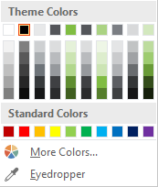
Slide Palette Info
The PowerPoint palette for this template has been built for you and is shown below. Avoid using too many colors in your presentation.
Select the 4th color from the left for subheads and 1st level non-bulleted text color, or wherever “color” text is preferred over the default black/white text
Accent colors 1-6 – (6 Theme Colors to the far right)
Text
Dark 2
Accent 1
Accent 2
Accent 3
Accent 4
Accent 5
Accent 6
Use Accent 1 as the main accent color. Use Accent 2 and Accent 3 when additional colors are needed.
Use Accents 4-6 sparingly – only when more colors are necessary.

Slide 6
Chart Example

Slide 7
Lots of data? Minimalize and Plan
Gray is used to de-emphasize data that is less important. Use cool gray 3 or cool gray 7. See slide 7 for color formulas.
All elements have the same interior margins as text blocks.
When a chart or graphic, has more elements than can easily be aligned to the grid, align the outer edges of the group, top, bottom, left and right edges to the grid.
It is preferable to keep the group aligned to the left border.
130M
140M
125M
Other
Other
Other
Other
Other
Other

Slide 8
Chart Example

Slide 9
Notes (hidden)
Some speakers like to use this slide for hidden “notes slides”.
Delete it if you don’t want to use it.

Slide 10



GLOBAL POWER PLATFORM BOOTCAMP
Organized Globally, Held Locally

Slide 11
AI con Power BI
Raúl Saráchaga

Slide 12
AI con Power BI
Raúl Saráchaga

Slide 13








Raúl Saráchaga
Data Architect / Pi Consulting
Trainer Data / bi64pro
Lead Peru BI and Analytics Group
Lead Power Automate and Power Apps User Group

Slide 14
Agenda
Automated Insights
Sentiment Analysis
Data Science Extensions
Key Influencers
Automated ML

Slide 15
Automated Insights

Slide 16
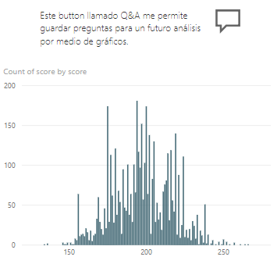
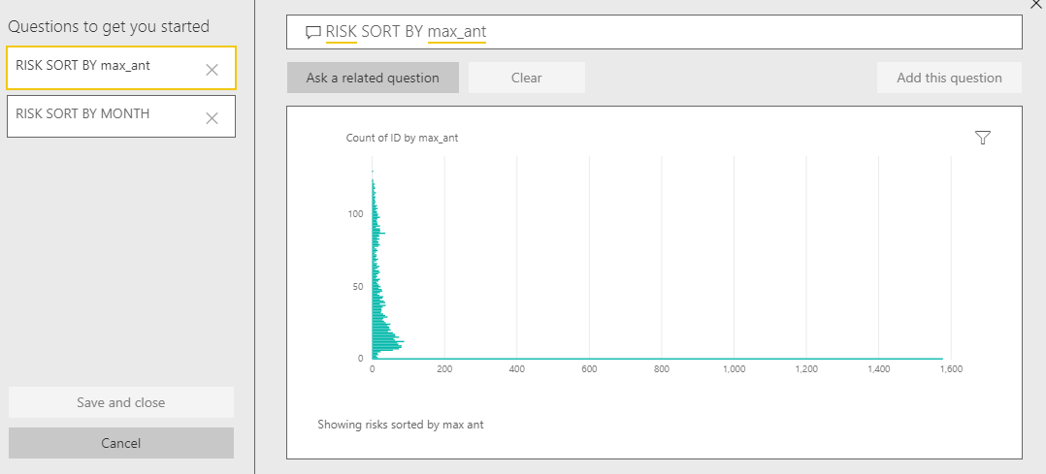
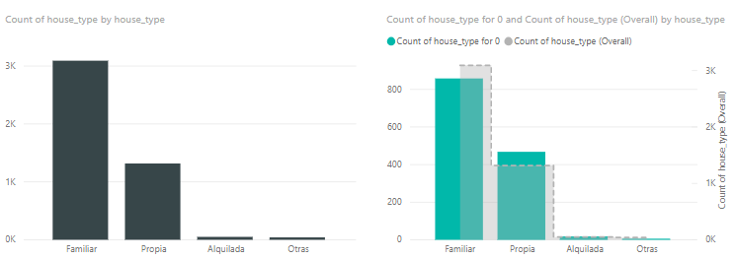
Overview

Slide 17
Demo

Slide 18
Sentiment Analysis

Slide 19
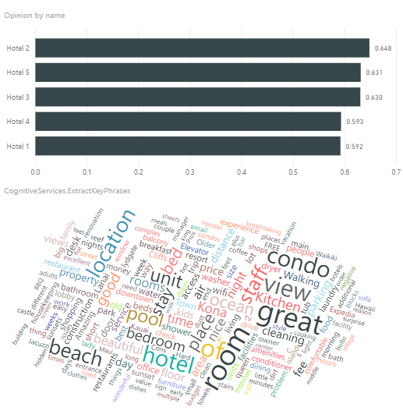
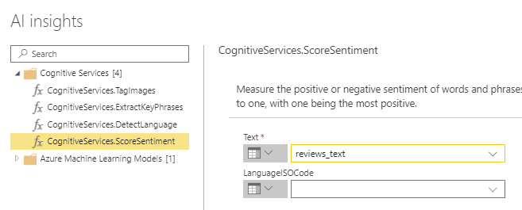
Overview

Slide 20
Demo

Slide 21
Automated ML

Slide 22
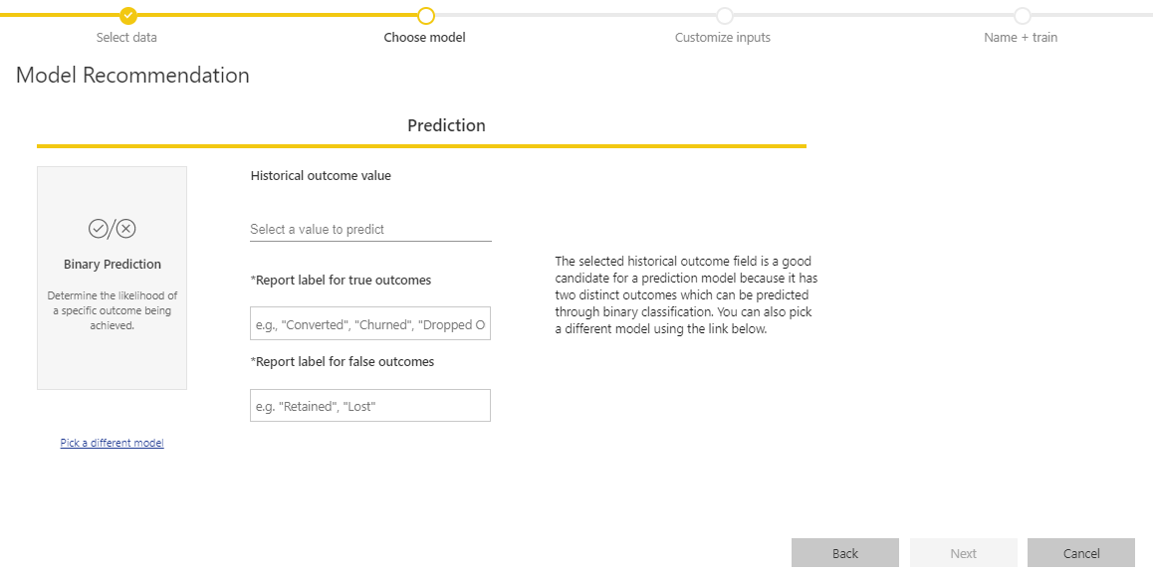
Overview

Slide 23
Demo

Slide 24
Data Science Extensions

Slide 25
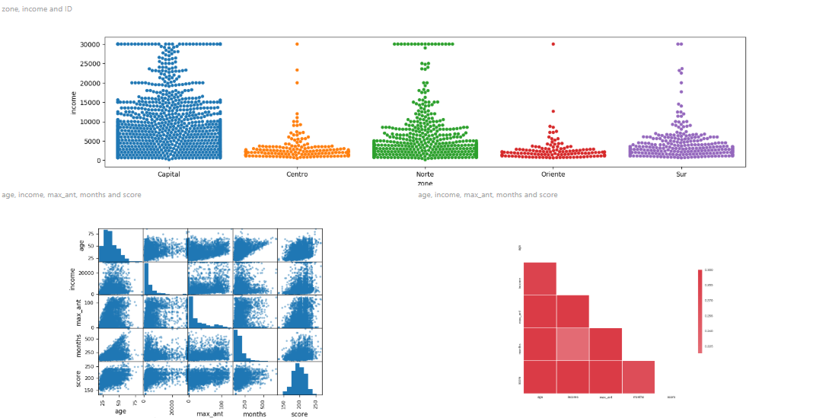
Overview

Slide 26
Demo

Slide 27
Key Influencers

Slide 28
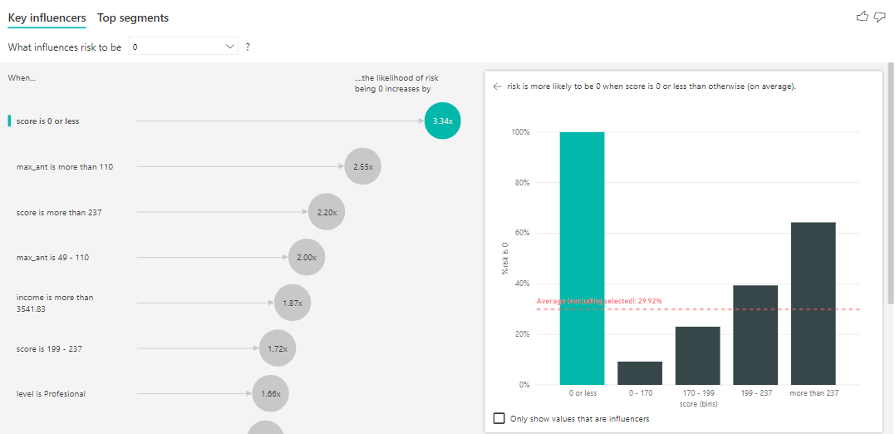
Overview

Slide 29
Demo

Slide 30
Any Questions?

Slide 31





Full Day
Power BI
30% de Descuento
7 de Marzo
Escríbenos a informes@bi64pro.com o a nuestras redes
BI64PRO

Slide 32





Full Day
BI con Azure
30% de Descuento
14 de Marzo
Escríbenos a informes@bi64pro.com o a nuestras redes
BI64PRO

Slide 33

Please fill out the survey! & Win Swags!!
https://www.powerplatformbootcamp.com/survey

Slide 34
Thank You For Attending

